Slide 1

Vivekananda institute of Technology and science
A Mini Project Review on
“Privacy Policy Inference of User Uploaded Images on Content Sharing Sites”
Under the Guidance of
Thangallapally Sahithi
Assistant Professor, CSE Dept Vits.
Submitted by
V. Rohan (21N61A0535)
B. Srinivas (21N61A0548)
A. Varun Kumar (21N61A0552)
V. Lavan Kumar (21N61A0527)

Slide 2

ABSTRACT
With the increasing volume of images users share through social sites, maintaining privacy has become a major problem, as demonstrated by a recent wave of publicized incidents where users inadvertently shared personal information. In light of these incidents, the need of tools to help users control access to their shared content is apparent. Toward addressing this need, we propose an Adaptive Privacy Policy Prediction (A3P) system to help users compose privacy settings for their images. We examine the role of social context, image content, and metadata as possible indicators of users’ privacy preferences. We propose a two-level framework which according to the user’s available history on the site, determines the best available privacy policy for the user’s images being uploaded. Our solution relies on an image classification framework for image categories which may be associated with similar policies, and on a policy prediction algorithm to automatically generate a policy for each newly uploaded image, also according to users’ social features. Over time, the generated policies will follow the evolution of users’ privacy attitude. We provide the results of our extensive evaluation over 5,000 policies, which demonstrate the effectiveness of our system, with prediction accuracies over 90 percent.

Slide 3


EXISTING SYSTEM:
Most content sharing websites allow users to enter their privacy preferences. Unfortunately, recent studies have shown that users struggle to set up and maintain such privacy settings.
One of the main reasons provided is that given the amount of shared information this process can be tedious and error-prone. Therefore, many have acknowledged the need of policy recommendation systems which can assist users to easily and properly configure privacy settings.

Slide 4
DISADVANTAGES:
Sharing images within online content sharing sites , therefore, may quickly lead to unwanted disclosure and privacy violations.
Further, the persistent nature of online media makes it possible for other users to collect rich aggregated information about the owner of the published content and the subjects in the published content.
The aggregated information can result in unexpected exposure of one’s social environment and lead to abuse of one’s personal information.

Slide 5

PROPOSED SYSTEM
In this paper, we propose an Adaptive Privacy Policy Prediction (A3P) system which aims to provide users a hassle free privacy settings experience by automatically generating personalized policies. The A3P system handles user uploaded images, and factors in the following criteria that influence one’s privacy settings of images:
The impact of social environment and personal characteristics. Social context of users, such as their profile information and relationships with others may provide useful information regarding users’ privacy preferences. For example, users interested in photography may like to share their photos with other amateur photographers.
The role of image’s content and metadata. In general, similar images often incur similar privacy preferences, especially when people appear in the images. For example, one may upload several photos of his kids and specify that only his family members are allowed to see these photos.

Slide 6
The A3P-core focuses on analyzing each individual user’s own images and metadata, while the A3P-Social offers a community perspective of privacy setting recommendations for a user’s potential privacy improvement. We design the interaction flows between the two building blocks to balance the benefits from meeting personal characteristics and obtaining community advice.
ADVANTAGES:

Slide 7

SYSTEM SPECIFICATION
Hardware Requirements:
System : Pentium IV 3.4 GHz.
Hard Disk : 40 GB.
Monitor : 14’ Colour Monitor.
Mouse : Optical Mouse.
Ram : 1 GB.

Slide 8
Software Requirements:
operating system : Windows Family.
Coding Language : J2EE (JSP, Servlet,Java Bean)
Data Base : MY Sql Server.
IDE : Eclipse Juno
Web Server : Tomcat 6.0
Software Requirements

Slide 9
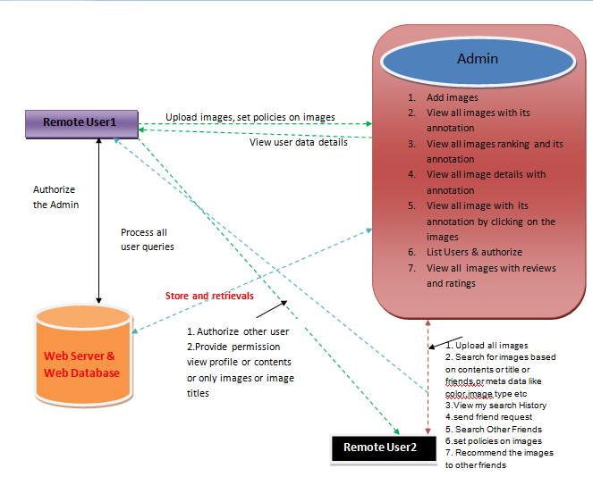
System Architecture :

Slide 10
Modules:
System Construction Module
Content-Based Classification
Metadata-Based Classification
Adaptive Policy Prediction

Slide 11
MODULES DESCSRIPTION:
> System Construction Module
The A3P system consists of two main components: A3P-core and A3P-social. The overall data flow is the following. When a user uploads an image, the image will be first sent to the A3P-core. The A3P-core classifies the image and determines whether there is a need to invoke the A3P-social. In most cases, the A3P-core predicts policies for the users directly based on their historical behavior. If one of the following two cases is verified true, A3P-core will invoke A3Psocial: (i) The user does not have enough data for the type of the uploaded image to conduct policy prediction; (ii) The A3P-core detects the recent major changes among the user’s community about their privacy practices along with user’s increase of social networking activities (addition of new friends, new posts on one’s profile etc).

Slide 12
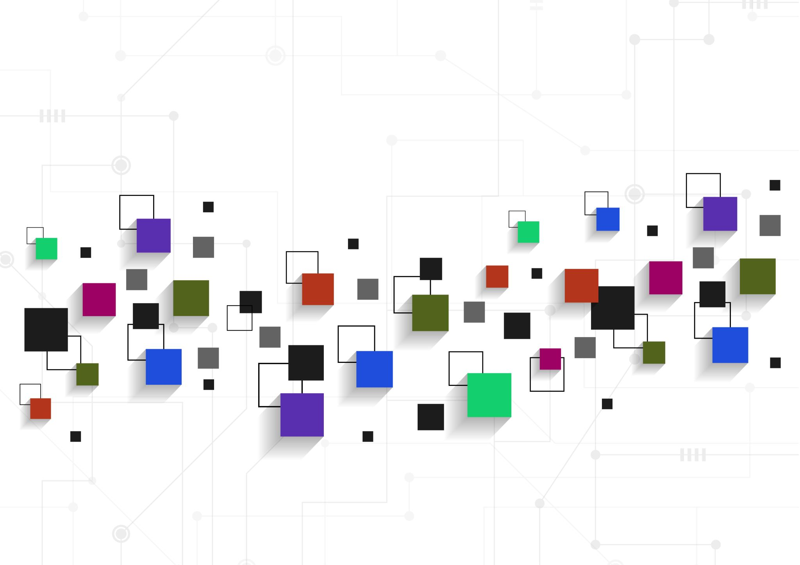

Content-Based Classification
To obtain groups of images that may be associated with similar privacy preferences, we propose a hierarchical image classification which classifies images first based on their contents and then refine each category into subcategories based on their metadata. Images that do not have metadata will be grouped only by content. Such a hierarchical classification gives a higher priority to image content and minimizes the influence of missing tags. Note that it is possible that some images are included in multiple categories as long as they contain the typical content features or metadata of those categories.
Our approach to content-based classification is based on an efficient and yet accurate image similarity approach. Specifically, our classification algorithm compares image signatures defined based on quantified and sanitized version of Haar wavelet transformation. For each image, the wavelet transform encodes frequency and spatial information related to image color, size, invariant transform, shape, texture, symmetry, etc. Then, a small number of coefficients are selected to form the signature of the image. The content similarity among images is then determined by the distance among their image signatures.

Slide 13

Metadata-Based Classification
The metadata-based classification groups images into subcategories under aforementioned baseline categories. The process consists of three main steps. The first step is to extract keywords from the metadata associated with an image. The metadata considered in our work are tags, captions, and comments. The second step is to derive a representative hypernym (denoted as h) from each metadata vector. The third step is to find a subcategory that an image belongs to. This is an incremental procedure. At the beginning, the first image forms a subcategory as itself and the representative hypernyms of the image becomes the subcategory’s representative hypernyms.
Adaptive Policy Prediction
The policy prediction algorithm provides a predicted policy of a newly uploaded image to the user for his/her reference. More importantly, the predicted policy will reflect the possible changes of a user’s privacy concerns. The prediction process consists of three main phases: (i) policy normalization; (ii) policy mining; and (iii) policy prediction.

Slide 14
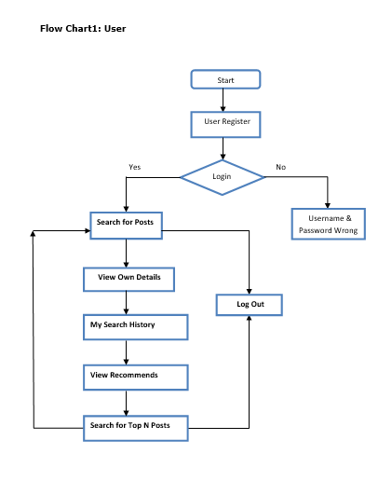
UML Diagrams:

Slide 15
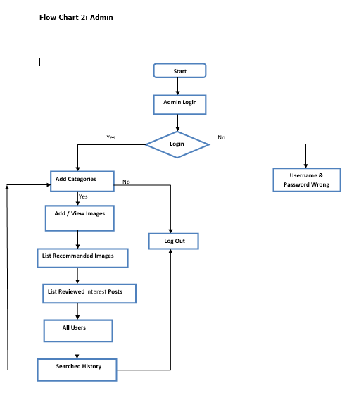

Slide 16
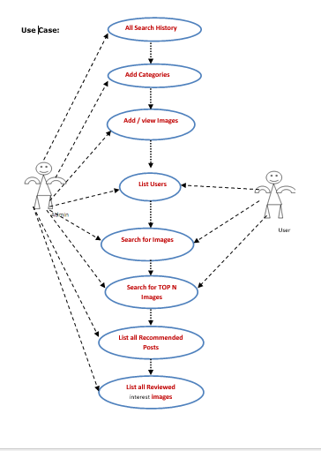

Slide 17
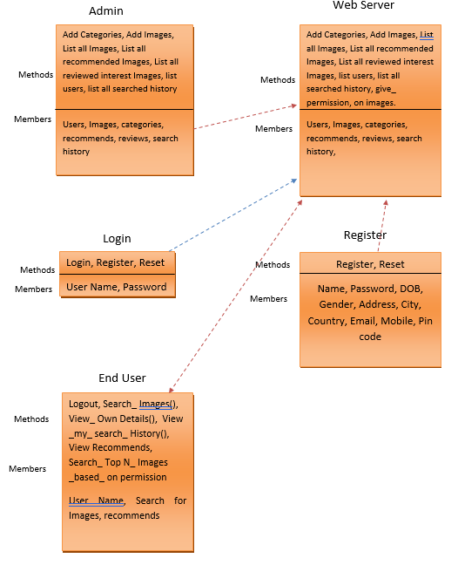
Class Diagram:

Slide 18
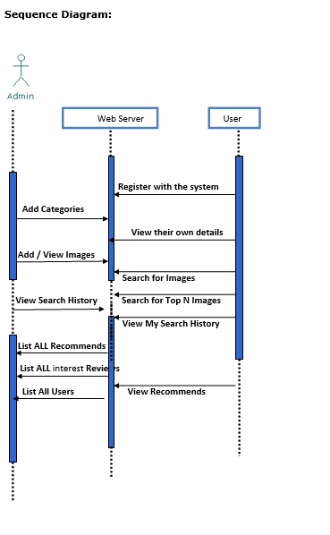

Slide 19
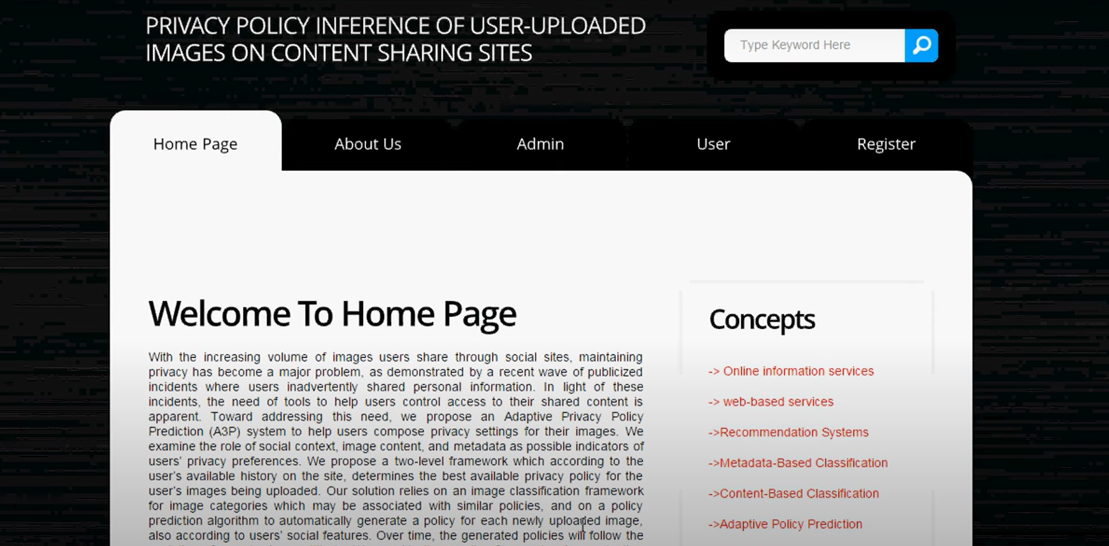
Output Screens:

Slide 20
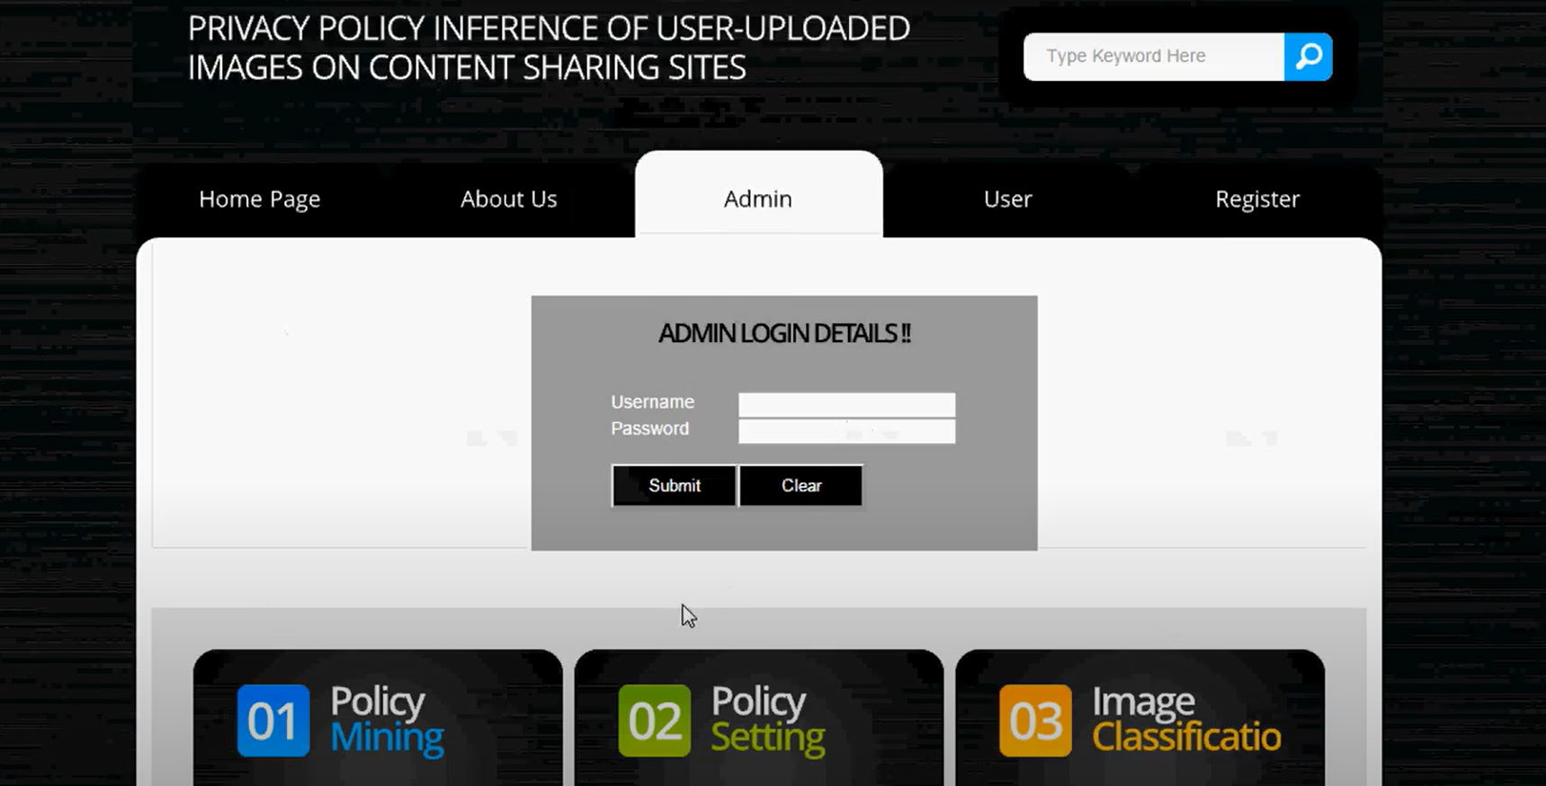

Slide 21


Slide 22
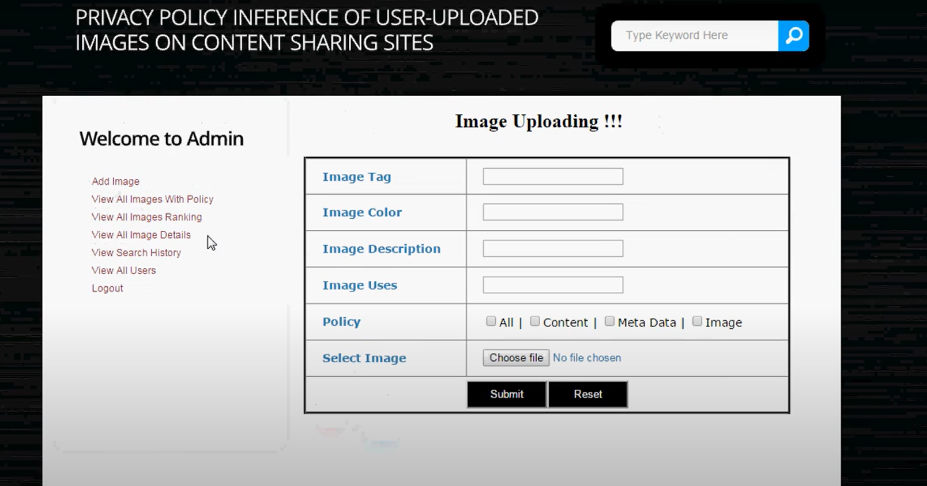

Slide 23
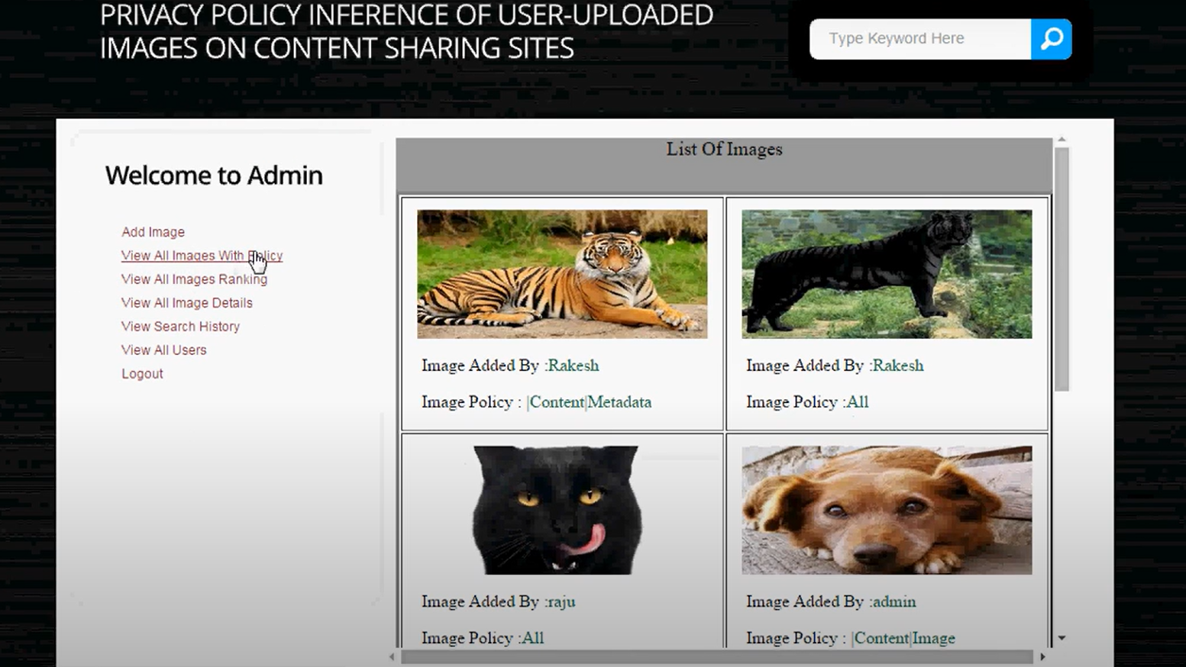

Slide 24
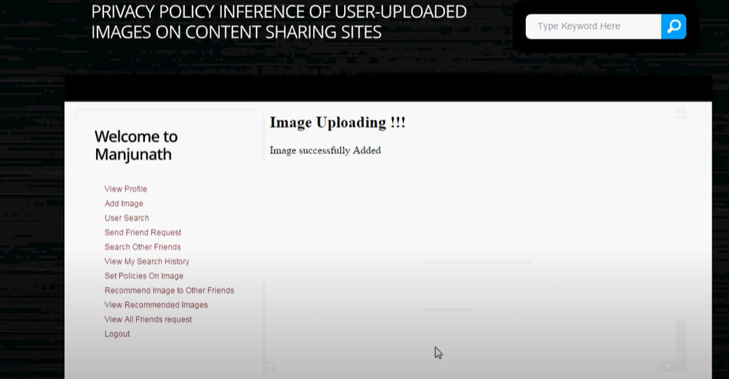

Slide 25
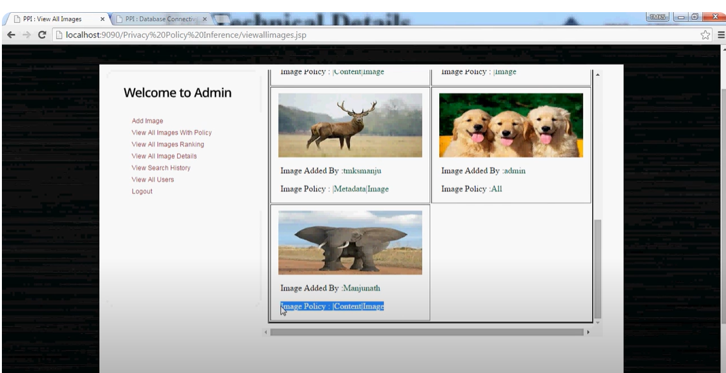

Slide 26
Conclusion
We have proposed an Adaptive Privacy Policy Prediction (A3P) system that helps users automate the privacy policy settings for their uploaded images. The A3P system provides a comprehensive framework to infer privacy preferences based on the information available for a given user. We also effectively tackled the issue of cold-start, leveraging social context information. Our experimental study proves that our A3P is a practical tool that offers significant improvements over current approaches to privacy.

Slide 27
Thank you
V. Rohan (21N61A0535)
B. Srinivas (21N61A0548)
A. Varun Kumar (21N61A0552)
V. Lavan Kumar (21N61A0527)

